Slide 1
SciLifeLab Bioinformatics Platform National Bioinformatics Infrastructure Sweden (NBIS) www.nbis.se
Björn Nystedt
bjorn.nystedt@scilifelab.se
Manager, Bioinformatics Long-term Support (WABI)

Slide 2
What is SciLifeLab?
Government: One of the three main research infrastructures in Sweden, along with MAX-IV and ESS
Max-IV
ESS

Slide 3
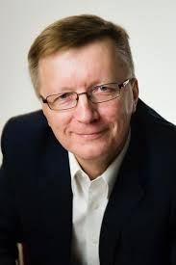
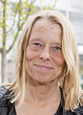
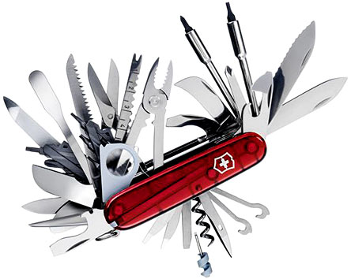
SciLifeLab
SciLifeLab
National service
The Swiss army knife for Swedish
Life Science researchers
Local scientific center
Director: Olli Kallioniemi
Co-director: Siv Andersson
Vision:
To be an internationally leading center that develops, uses and provides access to advanced technologies for molecular biosciences with focus on health and environment.
2010: Strategic research initiative
2013: National resource
2015: New management/chairman
www.scilifelab.se

Slide 4
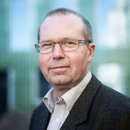

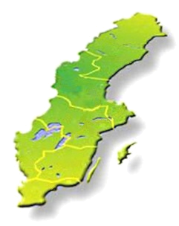
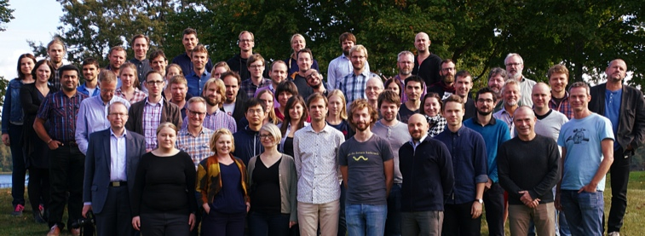
SciLifeLab platforms
SciLifeLab national service
VR
National Genomics Infrastructure
Clinical Diagnostics
Functional Genomics
National Bioinformatics Infrastructure
Sweden
SNIC
Bengt Persson
Computer resources free for Swedish researchers

Slide 5
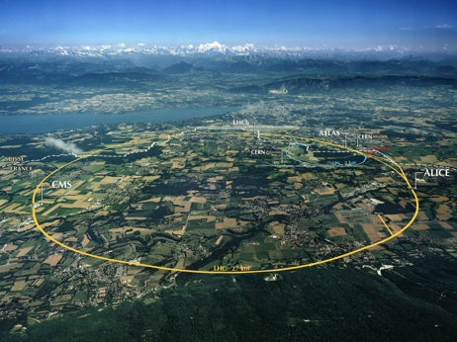

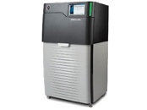
CERN vs Illumina
CERN: $5 billion
Illumina market value: $45 billion

Slide 6
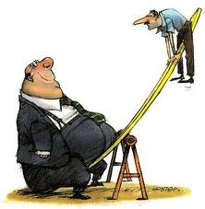
Production is cheap, analysis is not
Cost
Cost
Bioinformatics analyses
Computing
Data
Data
Year
Year
“Per base”
“Per project”
.
Our role
We want to help the Swedish Life Science community to build knowledge in large-scale data analysis, and to make bioinformatics easily accessible for all.
Data scientists
Data

Slide 7

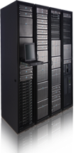
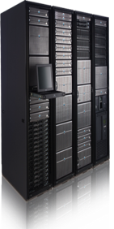

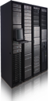
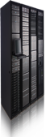
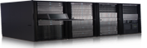
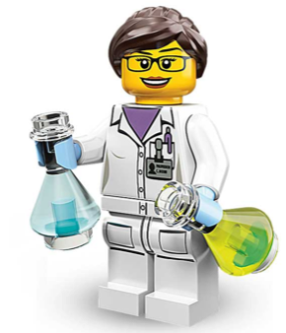




NBIS: Support, Tools and Training
400 consultations
Future compute environments
800 compute projects
200 software and databases
30 training events
500 PhD/post-docs
Data publishing and open science
Secure sharing of sensitive data
150 research projects
Efficient tools and workflows

Slide 8
Support tracks
https://nbis.se/support/
Study design consultation (free) + drop-in sessions every week @ all 6 sites
Support (User fee 800 kr/h)
Partner Projects (Salary-based fee, part-time FTE)
Long-term Support and systems biology (500h, free, scientific peer-review)
Deadline today Jan 31!
(Next round in May 2020)
Annually ~400 consultations, ~100 new support projects

Slide 9
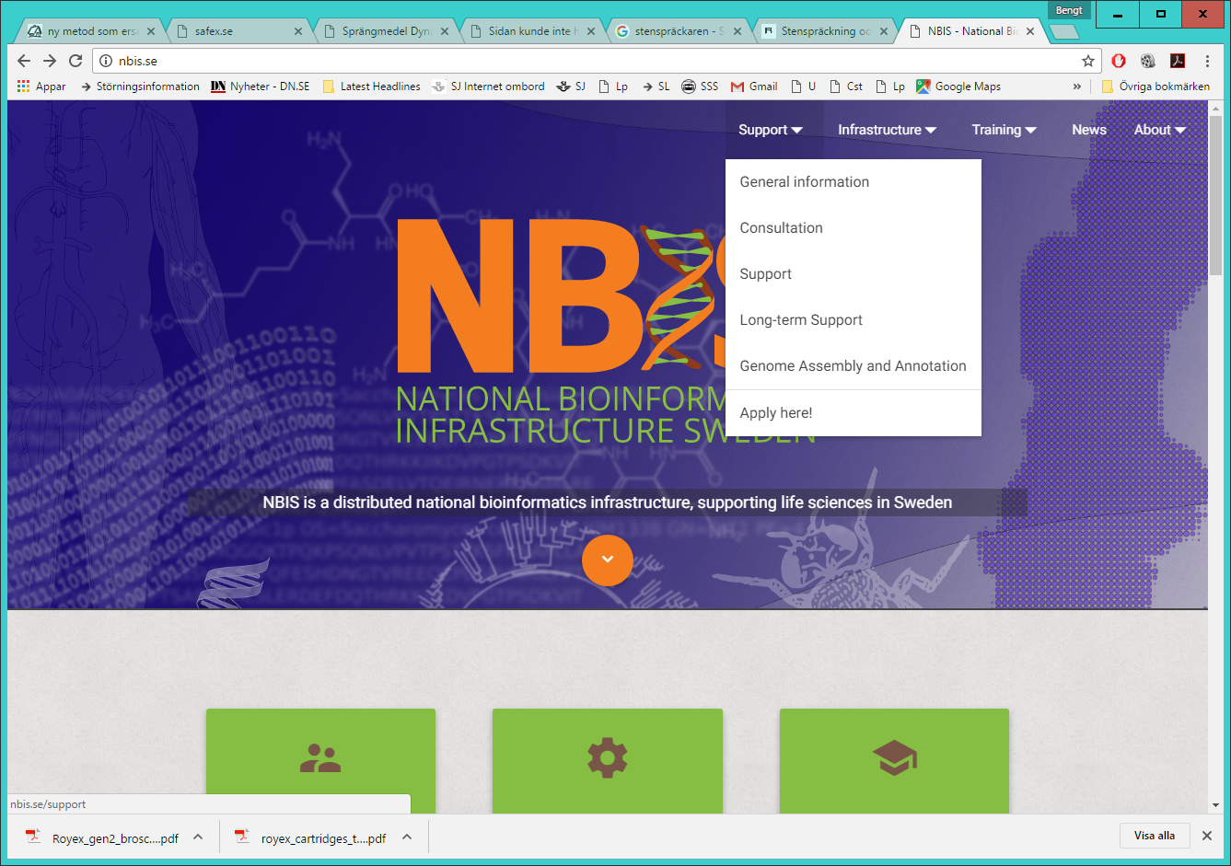
How to get support nbis.se

Slide 10
Support form

Slide 11
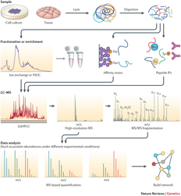

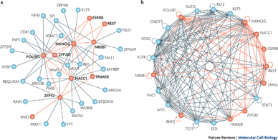
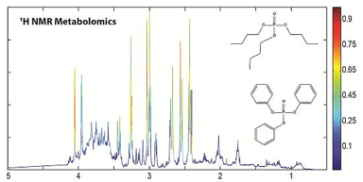

Bioinformatics support
Proteomics
Systems biology
Genomics
~100 new projects/year
Biostatistics
Metabolomics

Slide 12
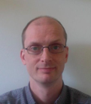
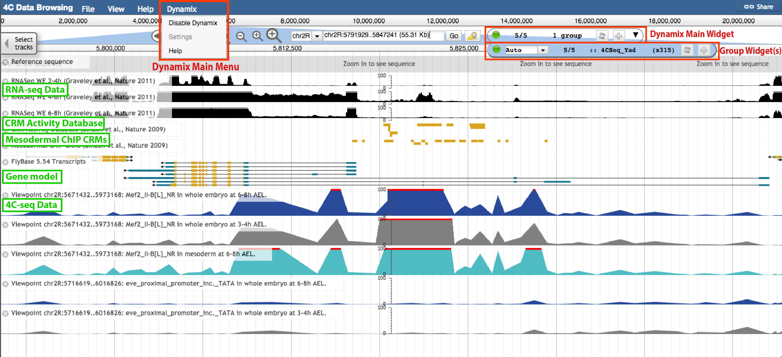
Genome assembly and annotation
Henrik Lantz
10 - 20 projects per year
Highly specialized staff and robust pipelines
Tight user interaction
Numerous manual and semi-manual QC steps
Supports ENA submission
Editable user interface
Cost effective with high quality!

Slide 13
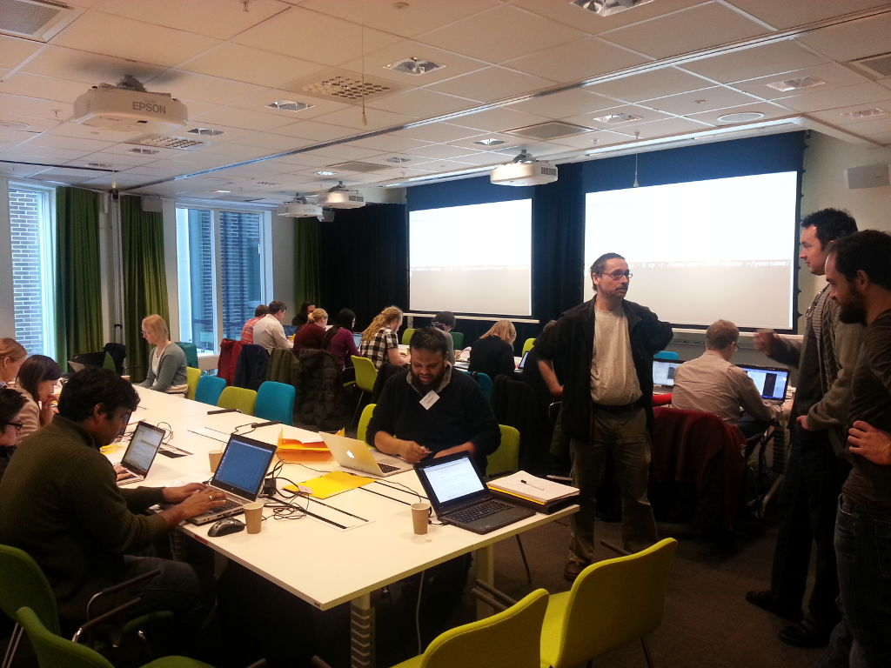


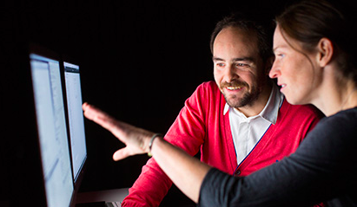

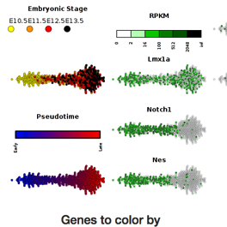
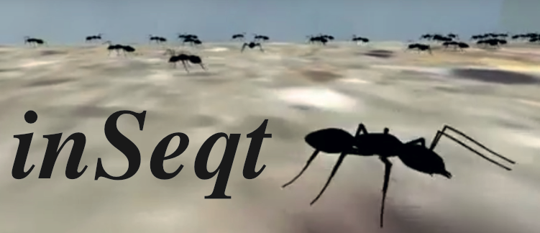
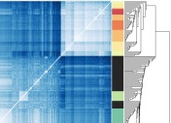


Training and tools
Hands-on workshops
Cancer Genomics Workflow
PhD mentoring program
1000 Swedish Genomes resource
IgDiscover
Grapevine
Summer School Visby
Spin-off tools

Slide 14
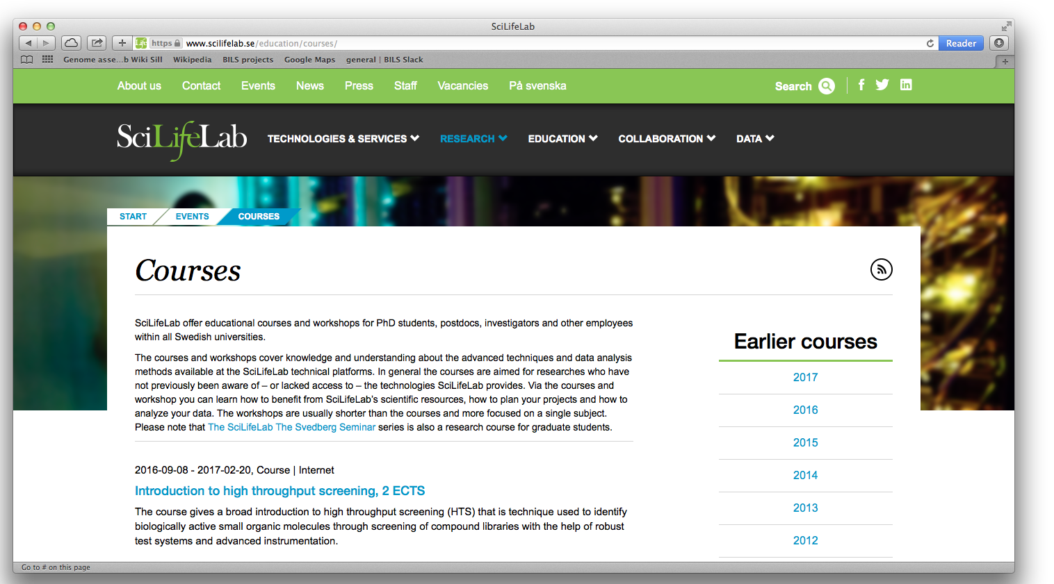
Course page

Slide 15

National PhD level bioinformatics courses
Joint efforts by SciLifeLab staff and researchers (+ more)
Introduction to omics data analysis
4 x Introduction to Bioinformatics using NGS data, 5 days (Manfred Grabherr)
1 x Omics data analysis, 10 days (Erik Fredlund, Lukas Orre)
Advanced topical courses
2 x RNAseq, 3 days (Johan Reimegård)
1 scRNA, 2 days (Åsa Björklund)
1 x Genome assembly, 2 days (Henrik Lantz)
1 x Genome annotation, 2 days (Henrik Lantz)
1 x Metagenomics, 2 days (Anders Andersson, Thijs Ettema)
1 x Proteomics, 4 days (Fredrik Levander)
Programming and reproducible research
1 x Reproducible research, 2 days (Rasmus Ågren, Leif Wigge)
2 x Python, 2 days (Frédéric Haziza, Sergiu Netotea)
2 x Perl, 5 days (Matt Webster)
1 x R Summer School, 10 days: RaukR (Marcin Kierczak) 1 x R programming Foundations for Life Scientists, 5 days (Marcin Kierczak)
1 x Unix/Linux Tutorial for beginners, 3 days (Mihaela Martis)
500+ students/year
Very positive course evaluations
Teacher-dense
Good for networking
R Summer School, Visby
www.scilifelab.se/education/courses/
www.nbis.se/training/events.html

Slide 16
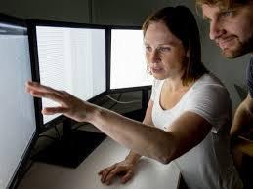
The Swedish Bioinformatics Advisory Program
PhD students get a senior bioinformatician as a personal advisor during 2 years of their PhD. Monthly project meetings + two grand meetings per year to aid networking and knowledge transfer.
www.scilifelab.se/education/mentorship/the-swedish-bioinformatics-advisory-program/
Deadline this Monday Feb 3!

Slide 17

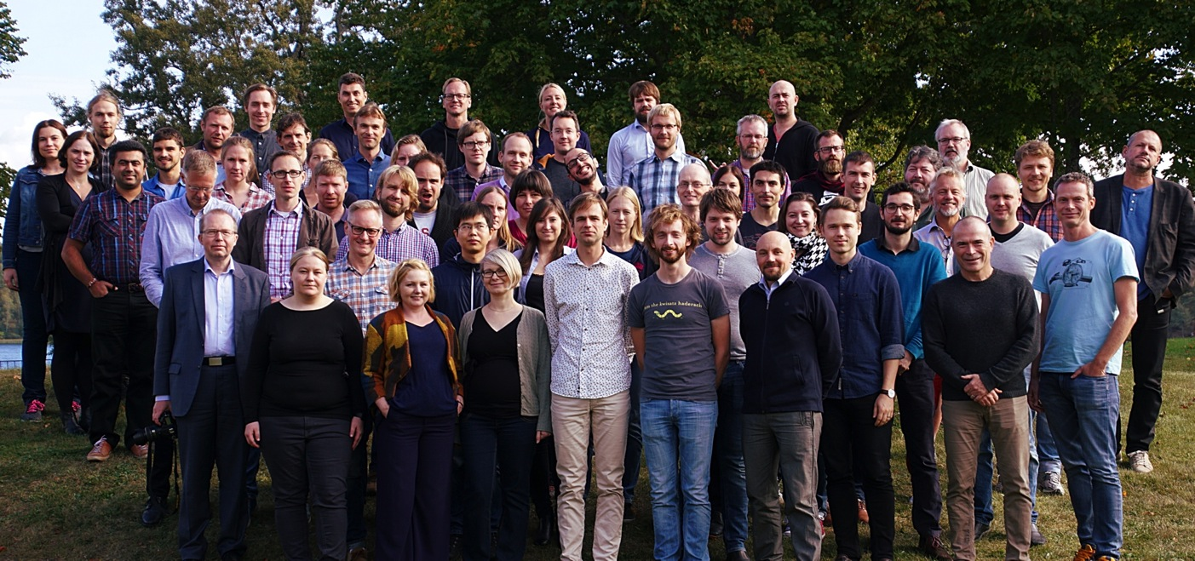













““..the infrastructure will greatly enhance the quality of analyses and data management and therefore of the scientific conclusions based upon the avalanche of data available.”
NBIS – a unique national resource
“[NBIS..] is crucial to the future competitiveness of Sweden in data-driven life sciences research, and is helping to keep Sweden in the European forefront in the area.”
The Swedish Research Council, 2017 and 2019 Overall score: 7/7 (“Outstanding”) Scientific impact: 7/7 (“Outstanding”)
www.nbis.se

